Slide 1


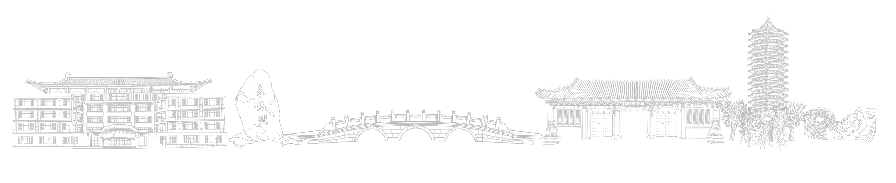
Peking University
Auto Prompt
李鹏宇 吴亮宇
2024年12月25日

Slide 2

Motivation
Why Auto Prompt?
“Let's think step by step.”
(Zero-shot CoT)
“Take a deep breath and work on this problem step-by-step.”
(OPRO)
GSM8K accuracy: 71.8%
GSM8K accuracy: 80.2%
Notes:
人工寻找更好的prompt肯定是一种比较低效的做法，那么我们需要（翻页）用到自动prompt的方法。

Slide 3
Motivation
Our research focuses on the field of Automatic Prompt.
Currently, most prompt construction methods are experimental and heuristic, and they require manual editing, especially for CoT prompts which necessitate the design of reasoning steps for each question individually.
Automatic Prompt can be conditioned on the current question to better elicit the capabilities of large models in-context, resulting in labor savings. In daily work, prompt engineering is also a mentally taxing task; if prompts can be optimized automatically, there would be no need to devise prompt methods oneself.
Notes:
好的prompt可以激发LLM的最大潜能

Slide 4
Background
Chain-of-thought Prompting
Zero-Shot CoT: LLMs are decent zero-shot reasoners whose generated rationales have already reflected the CoT reasoning
Manual CoT: elicit the CoT reasoning ability with effective manual demonstrations
In-Context Learning: feed a few prompted examples as part of the input

Slide 5
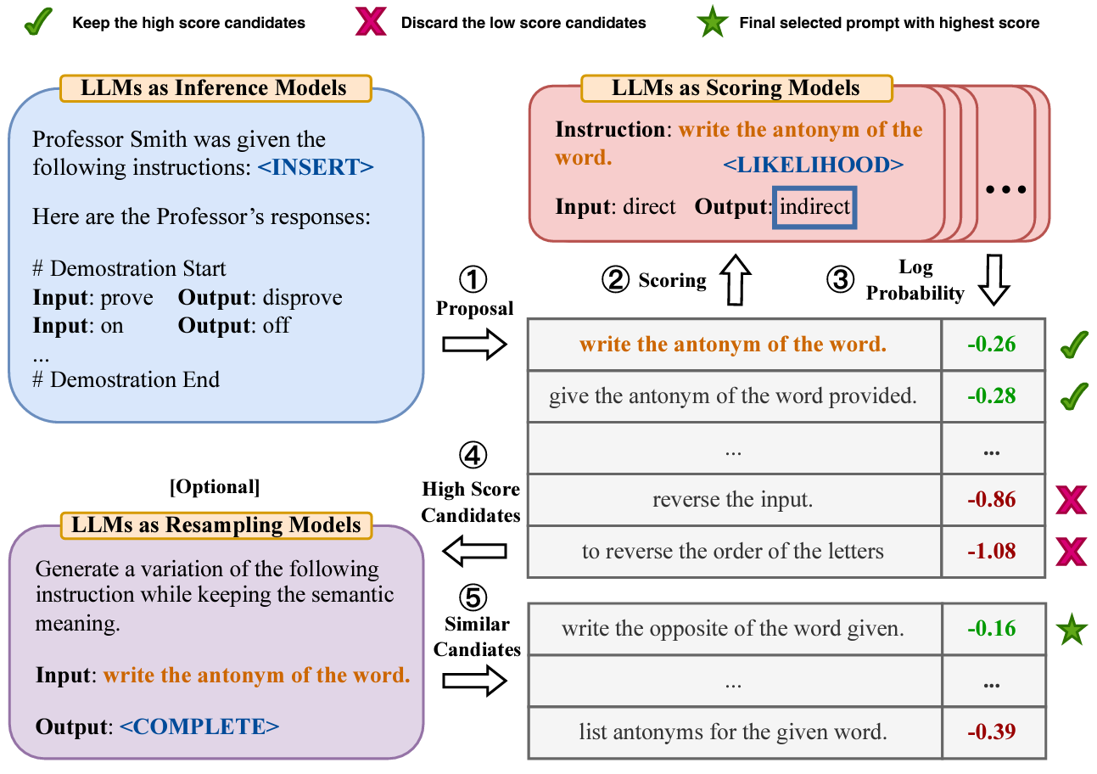
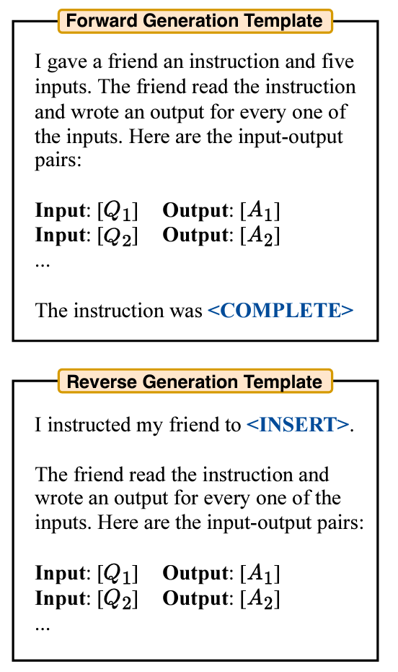
Background
Automatic Prompt
LLM as an Optimizer:
APE (Automatic Prompt Engineer): Select good prompts from the candidate set, and then conduct exploratory searches near the good prompts.

Slide 6
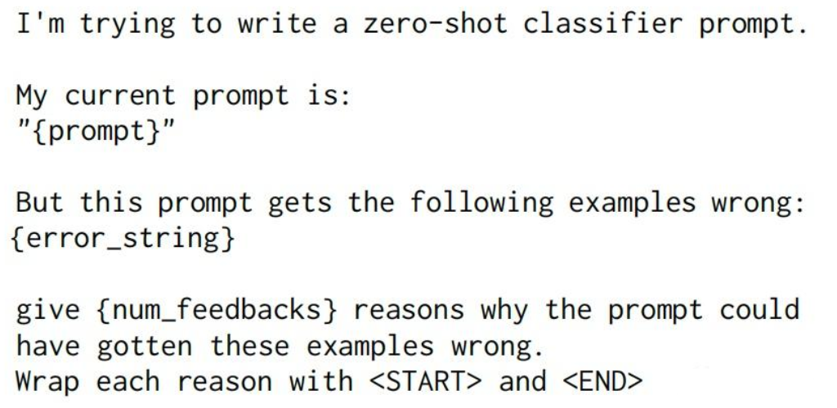
Background
Automatic Prompt
LLM as an Optimizer:
APO (Automatic Prompt Optimization): achieve gradient descent in language space

Slide 7
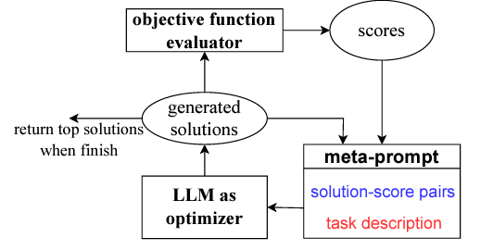
Background
Automatic Prompt
LLM as an Optimizer:
OPRO (Optimization by PROmpting): meta-prompt, based on the understanding of past iteration patterns, Optimizer LLM generates a new solution

Slide 8
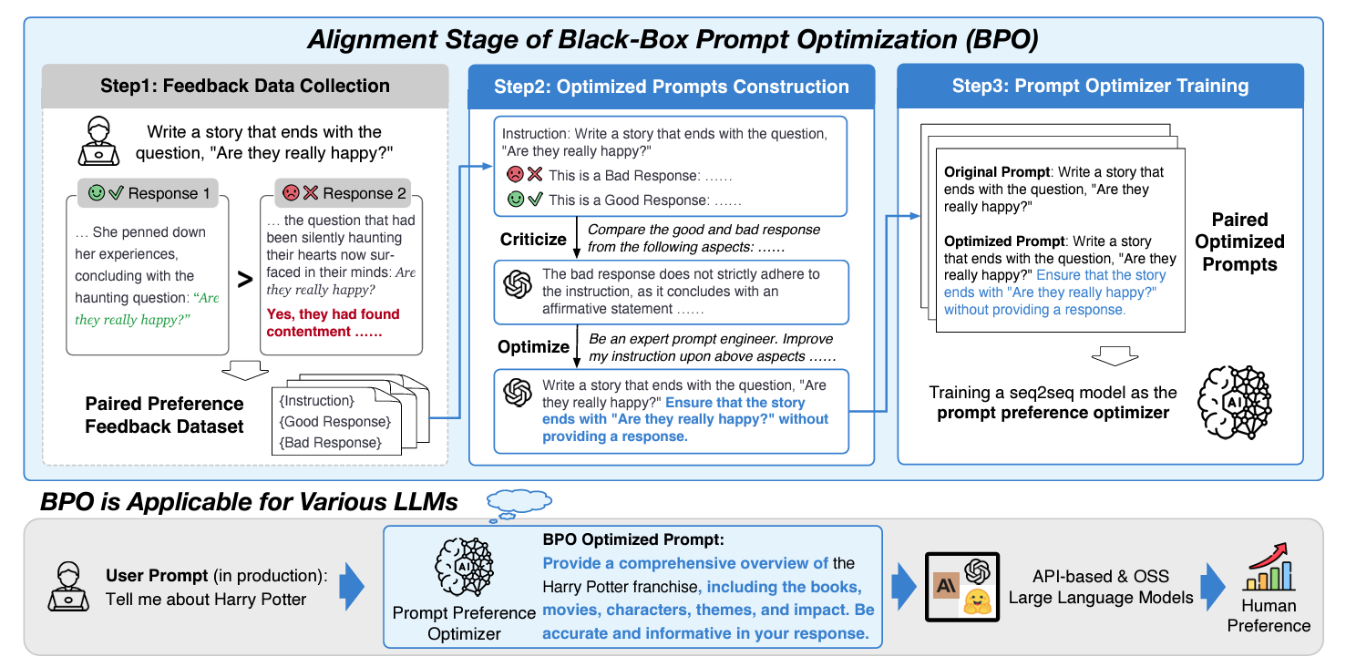
Background
Automatic Prompt
Build a sequence-to-sequence model:
BPO (Black-Box Prompt Optimization): align LLM without model training, learn from human preference data, compare chosen prompt and original prompt

Slide 9
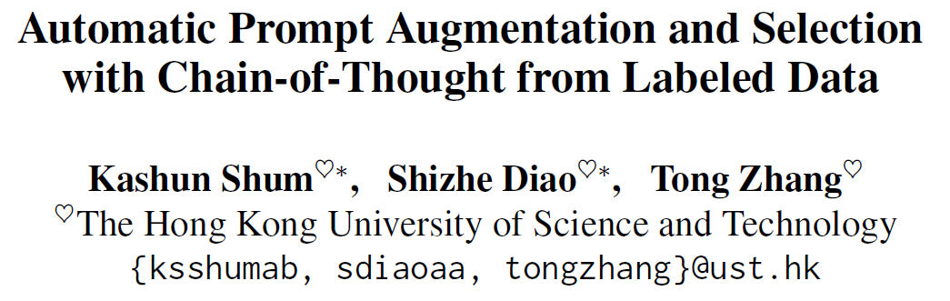
Background
Automatic Prompt
4 critical factors that affect the performance of chain-of-thought prompting and require large human effort:
(1) order sensitivity: the order combination of the exemplars
(2) complexity: the number of reasoning steps of the rationale chains
(3) diversity: the combination of different complex-level exemplars
(4) style sensitivity: the writing/linguistic style of the rationale chains
https://arxiv.org/abs/2302.12822

Slide 10
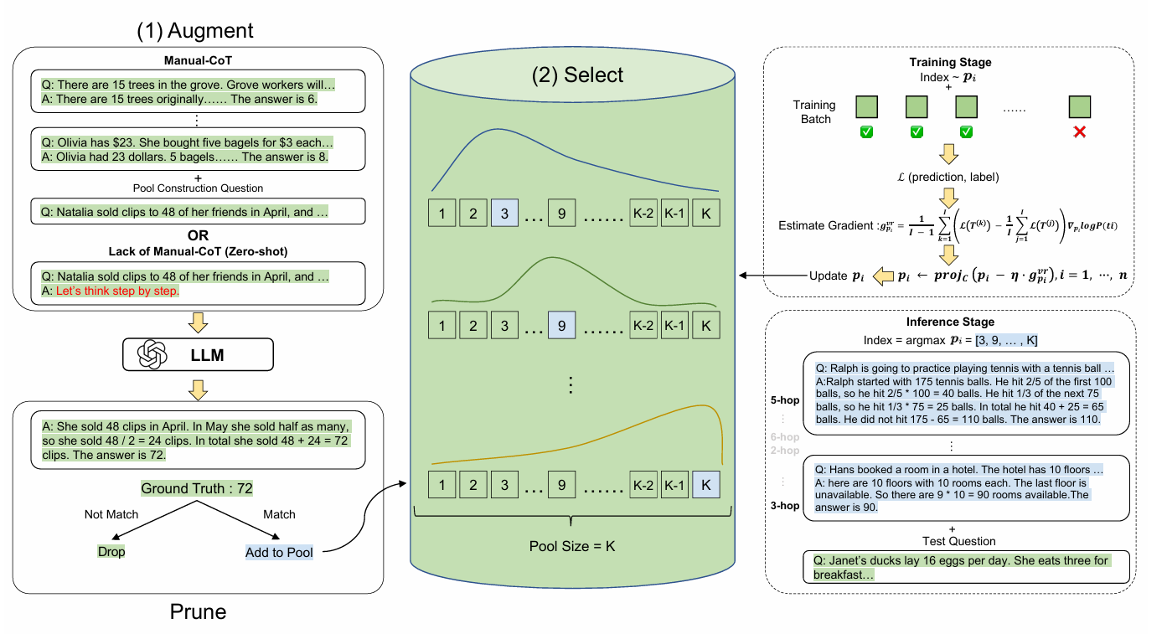
Method
Augment - Prune - Select
https://arxiv.org/abs/2302.12822
Notes:
人工撰写prompt的方式是选取一些问题，为这些问题撰写推理过程，然后得到答案
如何把这个过程自动化呢？这篇文章假设能够得到正确答案的推理过程大概率也是合理的，在这个假设下，我们首先通过大语言模型用CoT prompt生成回答，然后提取其中答案正确的回复，形成一个示例池

Slide 11
Method
Augment - Prune - Select
从示例池中，根据训练的分布选取n个示例，形成n-shot prompt。重复K次，形成K个n-shot prompt。
从训练集中，选取m个问题，计算由前面生成的prompt得到的正确率。
通过每一个n-shot prompt的正确率与整体的平均正确率之差，调整概率分布。
https://arxiv.org/abs/2302.12822
Notes:
在此基础上，我们希望自动优化先前提到的问题，包括某种示例的style和顺序可能得到更好的结果。
这篇文章设计了一个显式地训练过程，把采样每个位置的示例作为action，组合得到最终的prompt，然后将这个prompt在训练集上的正确率，作为反馈信号。
直觉上讲，如果某一个prompt的正确率高于平均，说明llm更喜欢，这一个prompt中选取的示例的风格，和顺序，提高该示例在对应位置被选取的概率。

Slide 12
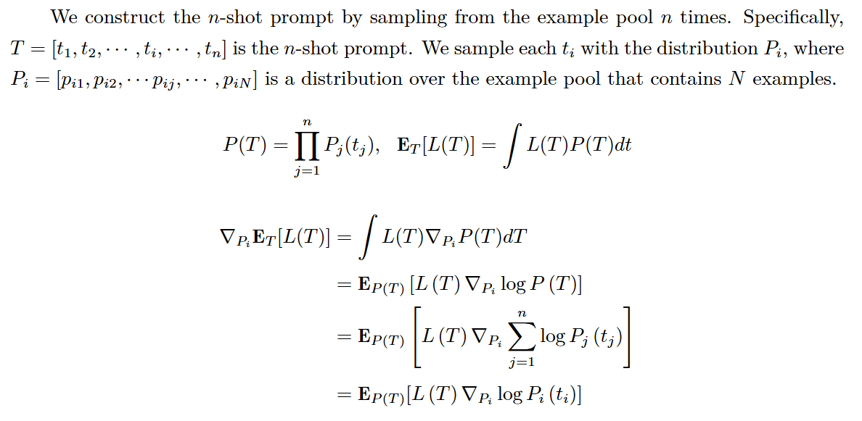
Derivation
Augment - Prune - Select
Notes:
具体的推导与策略梯度法比较相近，因为整个问题实际上建模成根据正确率信号，更新选取示例的策略的问题

Slide 13
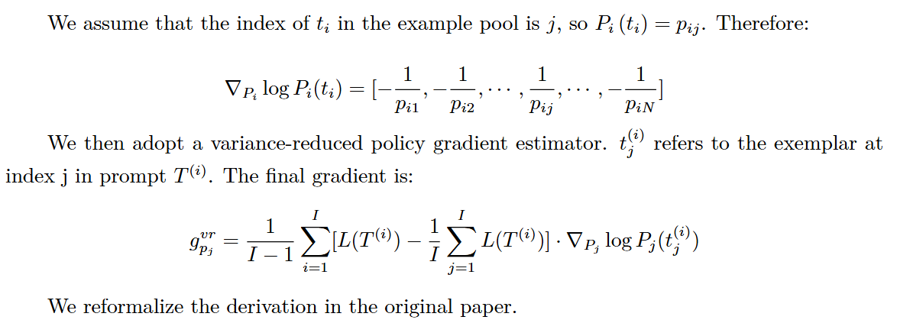
Derivation
Augment - Prune - Select
Notes:
当然在更新每个位置的概率的时候，求导上要对每个位置求
为了训练过程比较稳定，通过采样多个prompt组合，将某个prompt的反馈信号，设计为该prompt的准确率与平均准确率的差值

Slide 14
Generated CoT
Augment - Prune → Two exemplars in the pool
{
"Question": "Natalia sold clips to 48 of her friends in April, and then she sold half as many clips in May. How many clips did Natalia sell altogether in April and May?",
"Rationale": "Natalia sold 48 clips in April. In May, she sold half as many, which is 48 / 2 = 24 clips. To find the total number of clips sold in April and May, we add the two amounts together: 48 + 24 = 72 clips.",
"Answer": "The answer is 72.",
"Ground_truth": "72"
}
{
"Question": "Weng earns $12 an hour for babysitting. Yesterday, she just did 50 minutes of babysitting. How much did she earn?",
"Rationale": "First, we need to convert the 50 minutes into hours since Weng earns by the hour. There are 60 minutes in an hour, so 50 minutes is equivalent to 50/60 = 5/6 hours. Now, we can calculate her earnings: $12 per hour * (5/6) hours = $10. Weng earned $10 for 50 minutes of babysitting.",
"Answer": "The answer is 10.",
"Ground_truth": "10"
}
Notes:
我们可以看一下示例，可以看出生成正确答案的推理过程，确实是合乎逻辑的，而不是随便生成一些占位符，然后得到答案，认为auto prompt 的前提假设是合理的

Slide 15
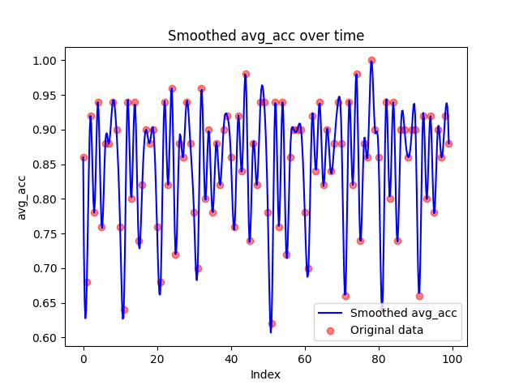
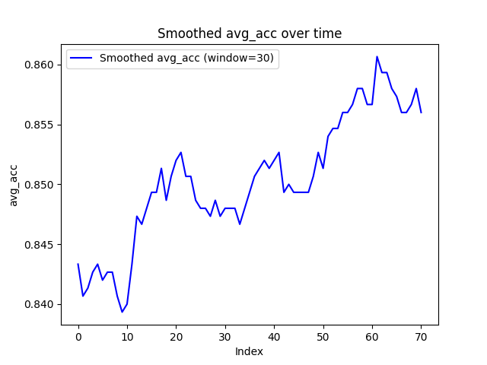
Training
Select
Notes:
训练的过程比较不稳定，但是整体趋势是向好发展的

Slide 16
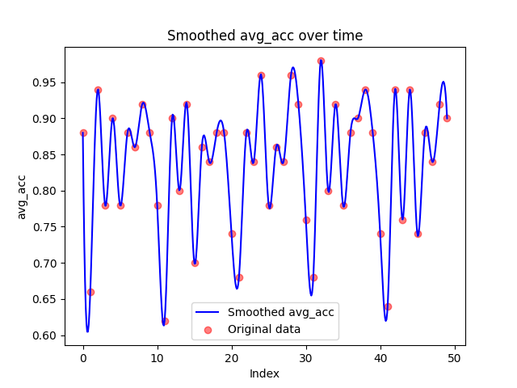
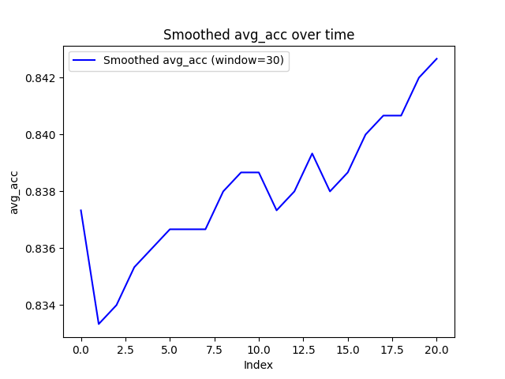
Training
Select
Notes:
这是另一种超参数的结果，可以看到是差不多的

Slide 17
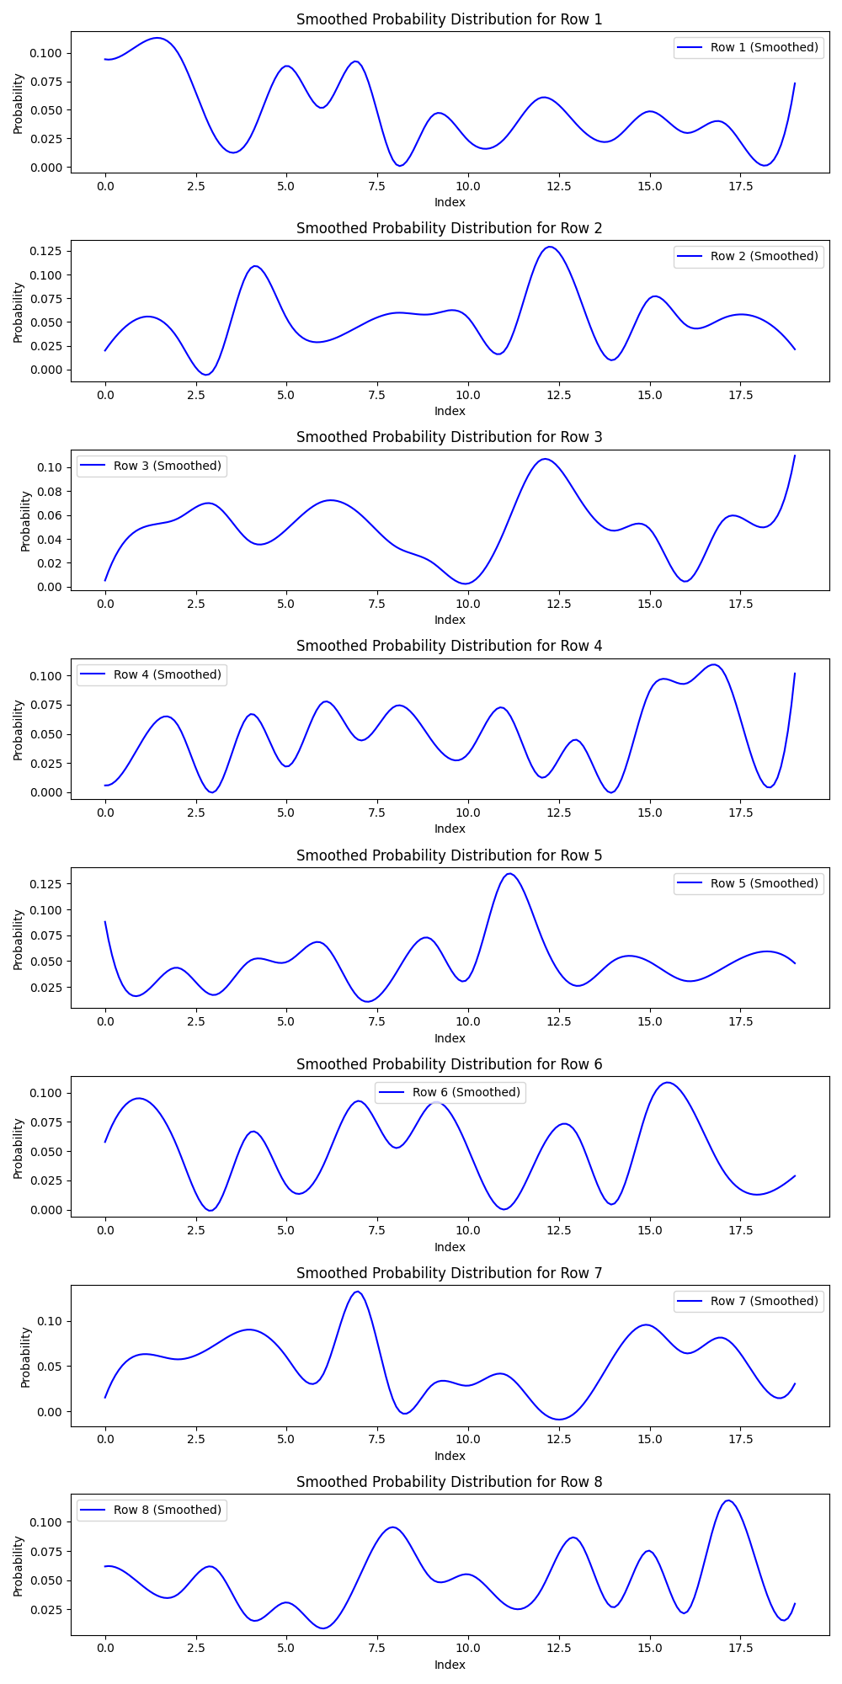
Final probs
Select
Notes:
可以形象地看一下最终选取每个位置示例的概率分布的样子，可以看到每个位置确实更偏好某些示例，形成多峰分布

Slide 18
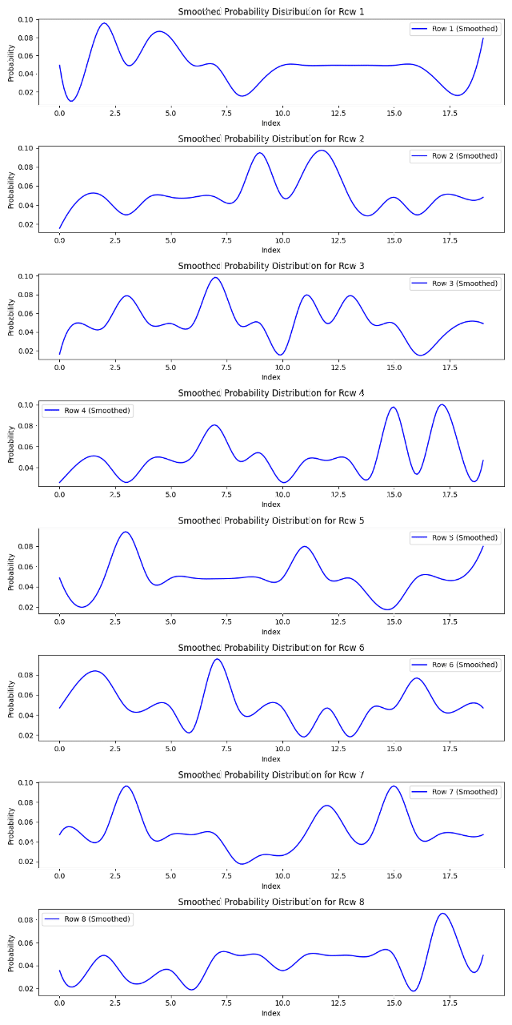
Final probs
Select
Notes:
在整个训练过程中，probs也是不断变化，从均匀分布，逐渐形成多峰分布的形式

Slide 19
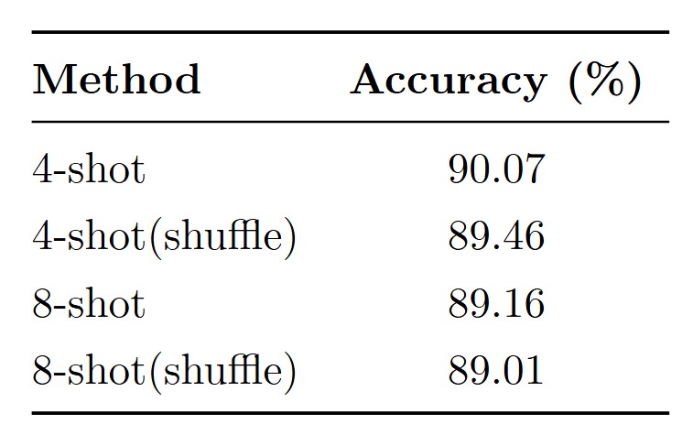
Evaluation
Do permutations influence the performance?
Notes:
Evaluation部分，我们首先希望看看文中说的顺序问题还会不会影响模型表现，毕竟相比davincie已经有很多进步。
可以看到在shuffle之后，测试的准确率还是有一定浮动，基本上在0.5%以内

Slide 20
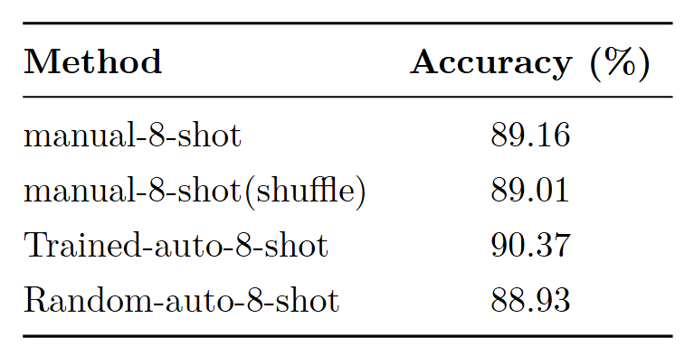
Evaluation
Check the effectiveness of the training process.
Notes:
接下来，我们希望验证这个训练过程的有效性，可以看到从训练好的分布中采样得到的prompt，比从示例池中随机采样的分布得到的prompt，在表现上要好
比人工合成的prompt，也 有所提升。

Slide 21
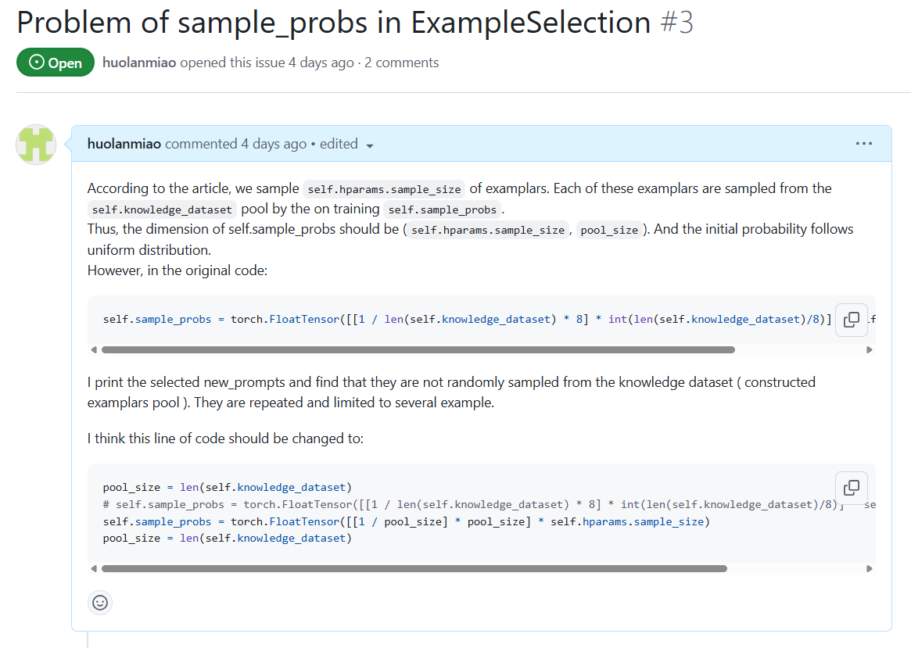
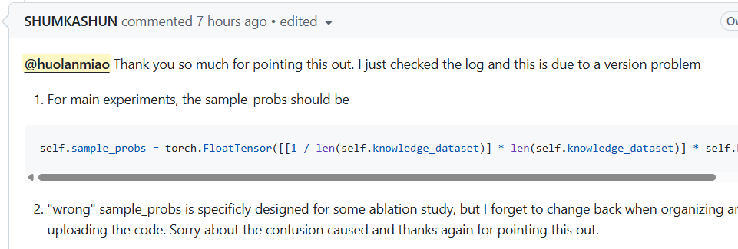
Report an issue
Notes:
在看代码的时候，也发现了代码中采样过程有一点bug，也得到作者肯定的答复，算是一个小插曲

Slide 22
Take away
Prompt engineering 目标是最大程度发挥模型潜力，完成原本不能完成的任务
充分依靠 Trail and Error 来探索更好的方法
Be aware of how model will process the instruction & how users will interact with the model.
依靠prompt engineering 激发的能力，会不断被建模到模型中，为模型能力的提升提供灵感
Notes:
在看代码的时候，也发现了代码中采样过程有一点bug，也得到作者肯定的答复，算是一个小插曲

Slide 23
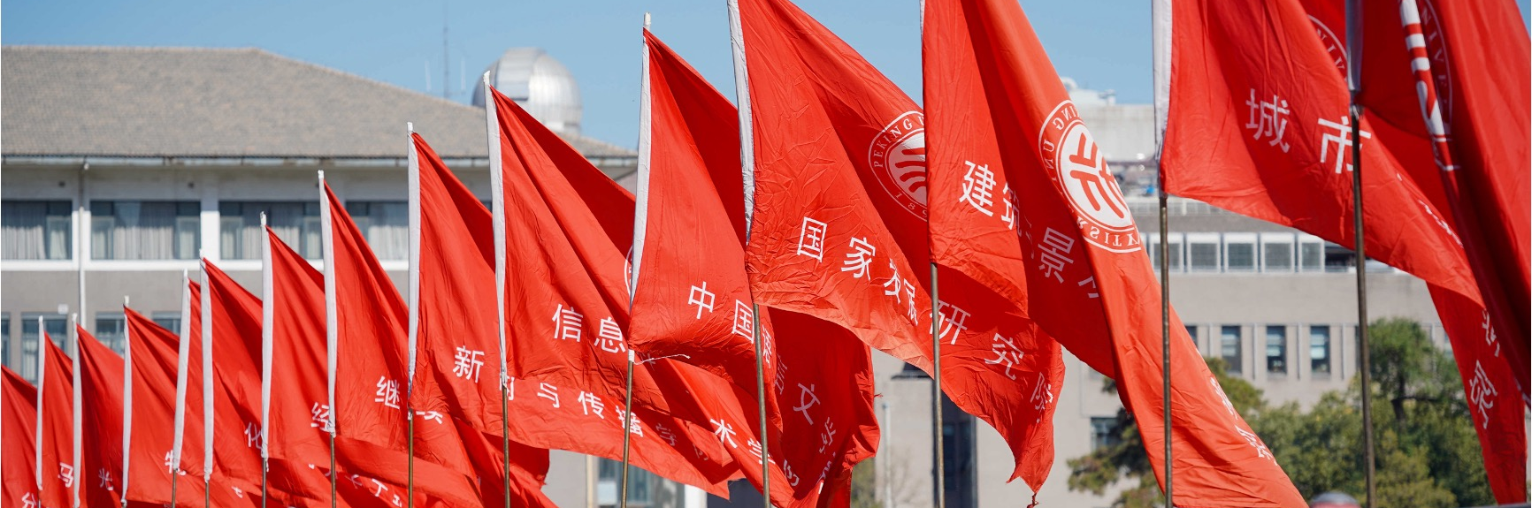
Peking University
谢
谢
观
看

